Slide 1

ECNet: Early Attention and Local Convolution for Machine Comprehension
Abhishek Goswami
3/20/2019

Slide 2
Problem Statement
Question
Economy, Energy and Tourism is one of the what?
Context
Subject Committees are established at the beginning of each parliamentary session, and again the members on each committee reflect the balance of parties across Parliament. Typically each committee corresponds with one (or more) of the departments (or ministries) of the Scottish Government. The current Subject Committees in the fourth Session are: Economy, Energy and Tourism; Education and Culture; Health and Sport; Justice; Local Government and Regeneration; Rural Affairs, Climate Change and Environment; Welfare Reform; and Infrastructure and Capital Investment
Answer
current Subject Committees

Slide 3
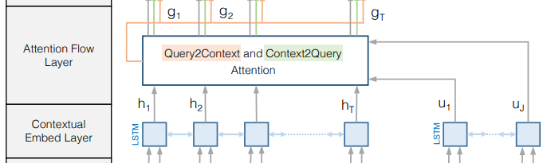
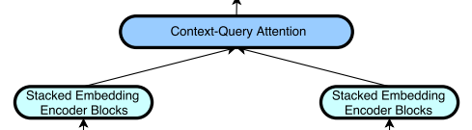
Motivation for ECNet
Most existing models have two common tenets
1. Embedding Encoder Layer.
models Contextual Cues between surrounding words
2. Attention Mechanisms
models Matching Cues between context and query
BiDAF [1]
QANet [2]
Can we amplify the existing models ?
Early Attention
Local Convolution

Slide 4
ECNet Model
Output Layer
p_{start}
p_{end}
Model Encoder Layer
M
Local Convolution
Attention Flow Layer
G
Embedding Encoder Layer
H
U
CNN
RNN
CNN
RNN
Embedding Attention Layer
X
Y
Early Attention
Embedding Layer
C
Q
char emb
word emb
char emb
word emb
Context Paragraph
Question

Slide 5
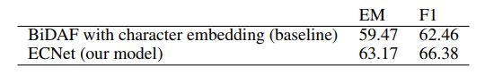
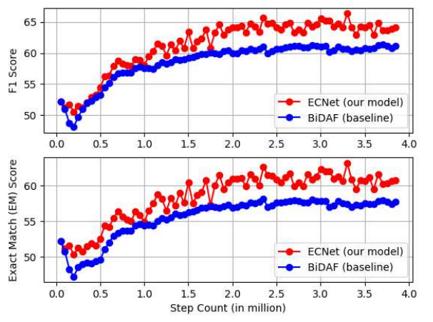
Results on SQuAD 2.0

Slide 6
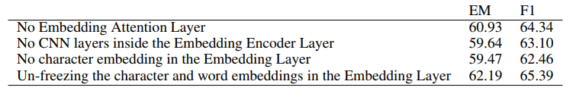
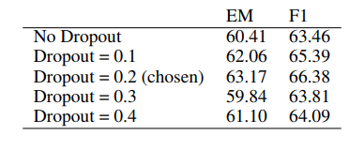
ECNet Ablation Study
Effect of Dropout

Slide 7
Conclusion
Studied the QA task
Propose the ECNet model
Early Attention
Local Convolution
Show ECNet outperforms BiDAF on SQUAD 2.0

